Slide 1
Quantum Convolutional Neural Networks
Chenyang Dong, Jiahui Luo
Notes:
Hi, this is group 5. Our research topic is quantum convolutional neural networks.

Slide 2
Introduction to QCNN
QCNN Architecture
QCNN Application
Advantages and Limitations
Notes:
We first going to introduce qcnn by comparing it to classical convolutional neural networks. Then we are going to talk about the architecture of qcnn in more details, with some applications, advantages and limitations of it.

Slide 3
Convolutional Neural Network (CNN)
Notes:
Convolutional neural networks have been proven effective in many machine learning applications, especially in image recognition. I’ll briefly talk about the architecture of cnn and compare it to that of qcnn.

Slide 4
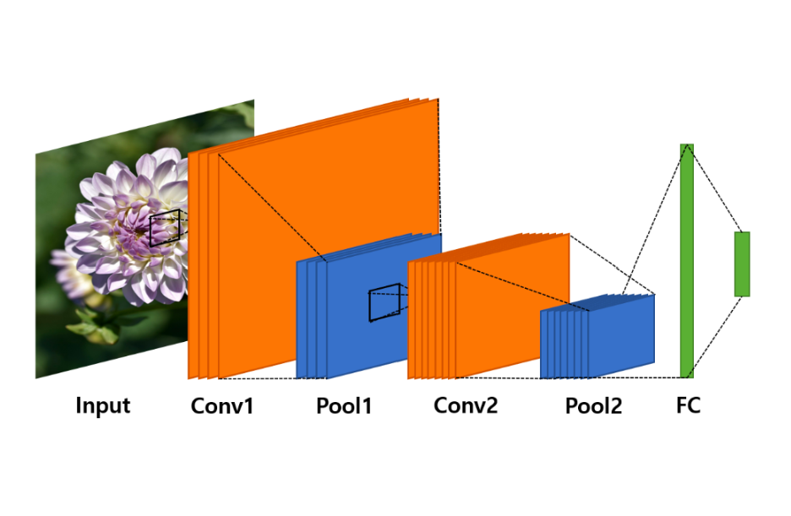
CNN Architecture
Convolutional layer
Pooling layer
Fully connected layer
Notes:
There are three main types of layers in cnn, the convolutional layer, the pooling layer, and the fully connected layer.

Slide 5
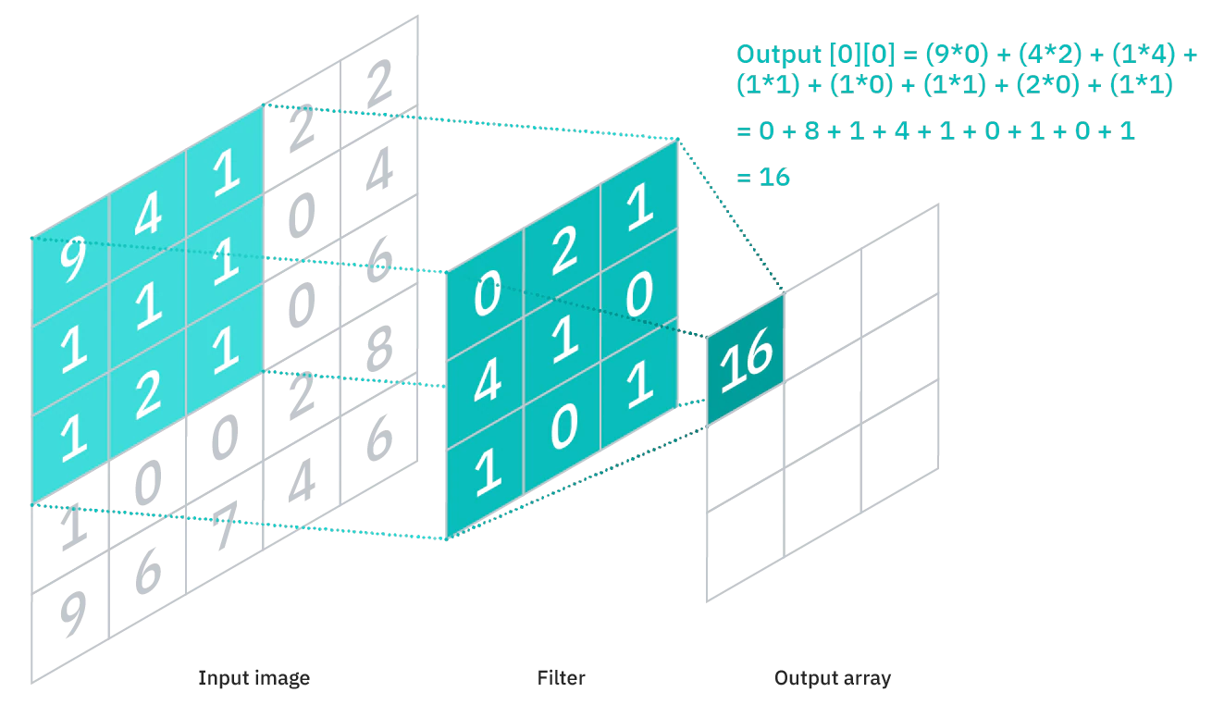
Convolutional Layer
Notes:
In a convolutional layer, there is a small matrix, called kernel, that is used to multiply with a small subset of the input data, to get an output. The kernel then slides along the input values to calculate the output for each cell. For example, (click) this cell will be calculated with (click) these values.

Slide 6
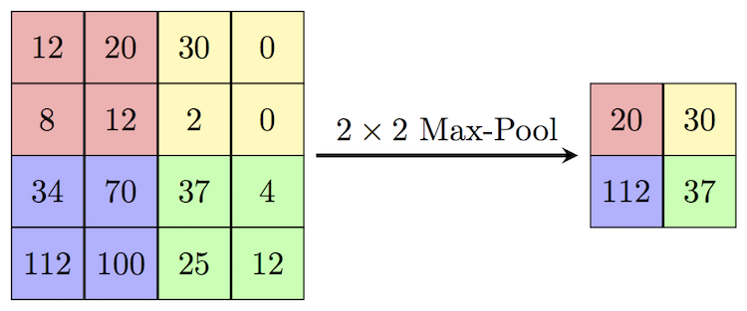
Pooling Layer
Notes:
For the pooling layer, the purpose is to reduce the dimension of the data. The example shown here is max pooling. It retains only the cell with the highest value in every four consecutive cells. Then the fully connected layer is just like any plain old neural networks.

Slide 7
Quantum - Convolutional Neural Network (QCNN)
Notes:
So, what happens when quantum is added to a convolutional neural network.

Slide 8
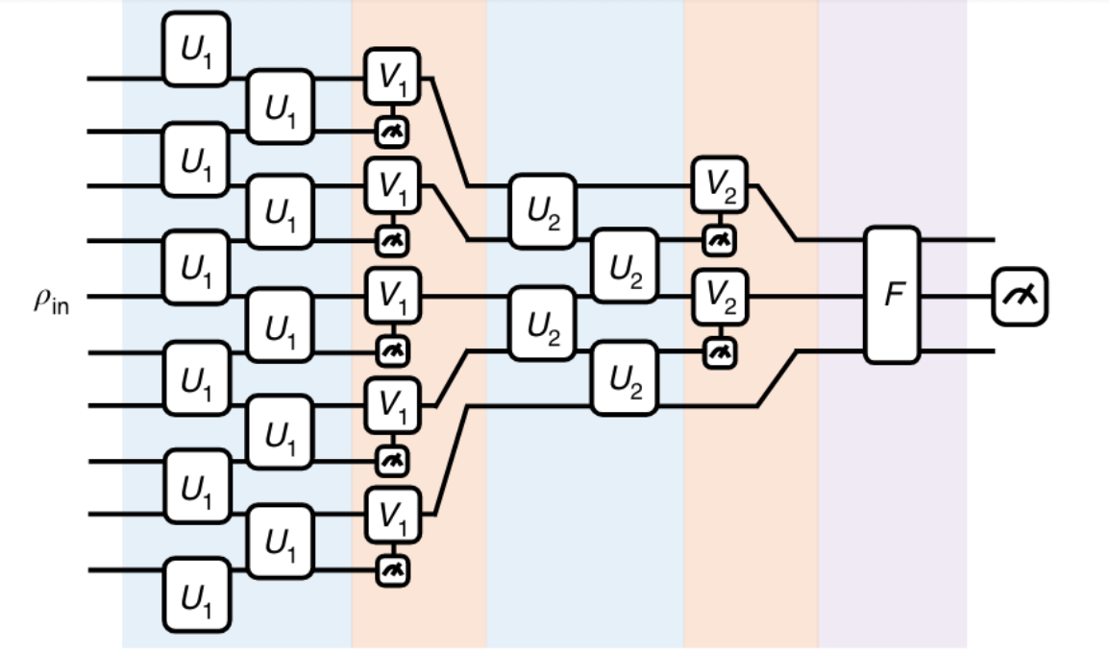
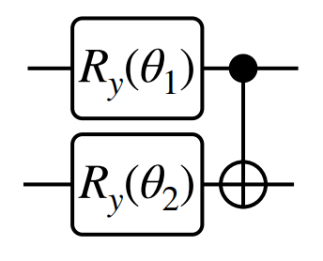
QCNN Architecture
Notes:
In order to apply the concept of classical cnn to quantum cnn, the convolution kernel is replaced by a parameterized quantum circuit. And within the circuit, there will be unitary operators which will act on the qubits.
(next)
A quantum convolutional layer contains two rows of two qubits unitaries which act on alternating pair of qubits, composed of variational parameters. It extracts features from all qubits in the local space of the data. It plays an important role in extracting complex features of the qubits for the whole network.
(next)
The unitaries can contain different types of quantum gates, including single or two-qubit gates, such as rotation gates or the CNOT gate. The two-qubit gates can act on neighboring qubits to realize the quantum entanglement between them.

Slide 9
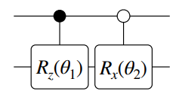
QCNN Architecture
Notes:
The quantum pooling layer is also similar to the classical one. In order to reduce the dimension of the features extracted with the convolutional layer, and reduce the size of the quantum system, it measures a fraction of the qubits, and the outcome will decide whether to apply unitaries on the remaining qubits.
(next)
In this example circuit, a measurement of 1 will induce a z-rotation and a measurement of 0 will cause an x-rotation.

Slide 10
QCNN Architecture
Notes:
By repeating the convolutional and pooling layer, the size of the system will eventually become sufficiently small, and then a fully connected circuit predicts the classification result with a non-local measurement.

Slide 11
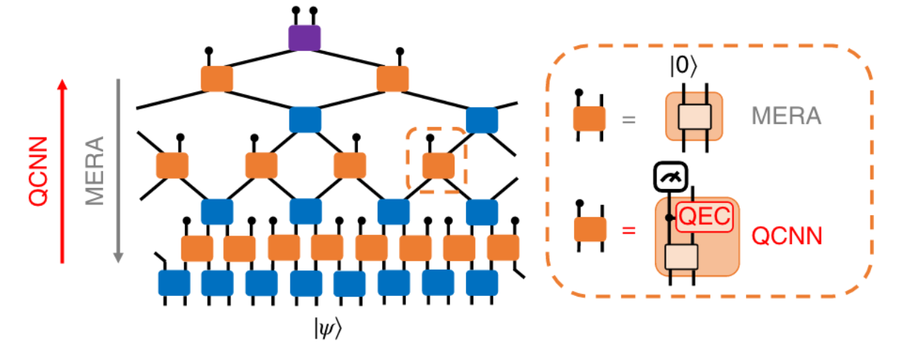
Important concepts of QCNN
Multi-scale Entanglement Renormalization Ansatz (MERA)
QCNN = +
Quantum Error Correction (QEC)
Notes:
While discussing about the architecture of Quantum Convolutional Neural Network, there are two important concepts which actually composed of QCNN. Multi-scale Entanglement Renormalization Ansatz and Quantum Error Correction. QCNN is simply the inverse of MERA circuit structure, and with QEC it helps solve certain problem of such structure.

Slide 12
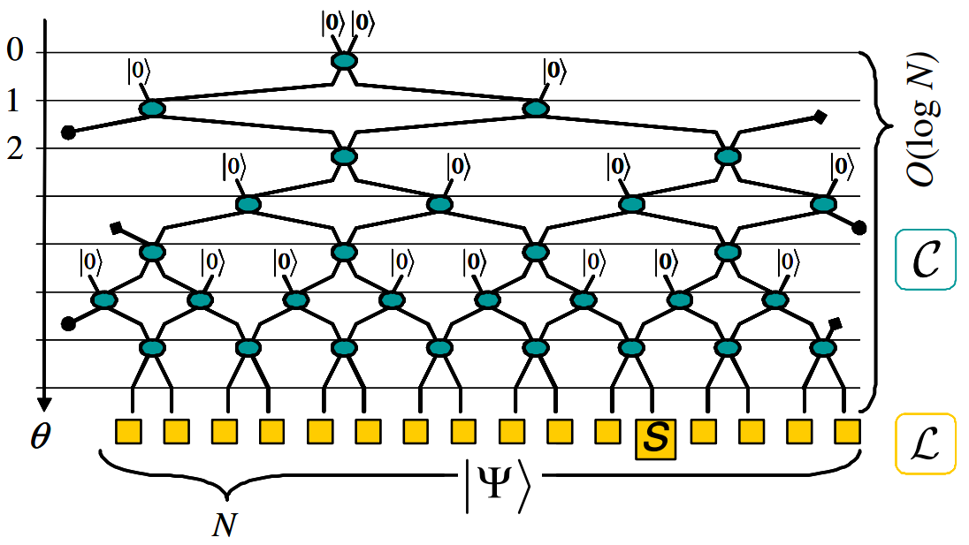
Multi-scale Entanglement Renormalization Ansatz (MERA)
Entanglement Renormalization Group (ERG)
Coarse graining
Isometry
Boundary deformation
Disentangler
Notes:
MERA is the model used to satisfy the structure of QCNN. It is designed to efficiently simulate many-body state quantum systems. And it can specify the layout of hierarchical circuit and algorithms for learning the parameters.
The core idea of MERA is entanglement renormalization group (ERG). In general, it starts from an initial state containing a known deterministic state, then gradually injecting new qubits, for instance zero qubit at every second row in the graph (next)
, and applying an entangling unitary called isometry between existing qubit and new qubit injected. After that, (next)
for other rows it’s basically using additional entangler to build the short-range entanglement between neighboring qubits and is able to capture a broader range of quantum correlations. Finally, it comes up with this tree-like tensor network.

Slide 13
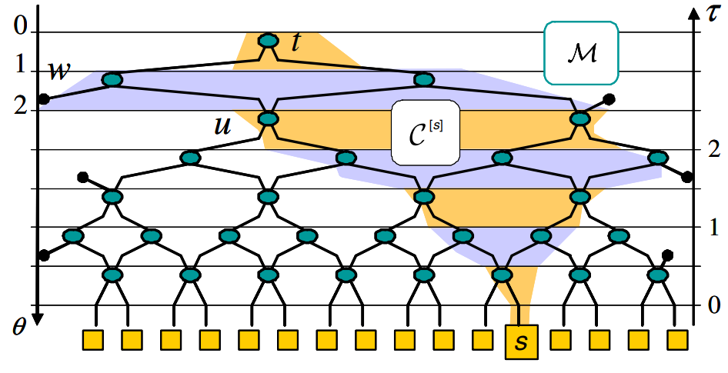
Importance of MERA structure
QCNN in a reversed direction
Deterministic measurement outcomes
Reduction on Variational Parameters
Only O(logN) parameters
Notes:
Since QCNN runs in a reversed direction of MERA circuit structure, the importance of such structure is that, for any given state |ψ〉 with a MERA representation, there is always a QCNN that recognizes the state|ψ〉 with deterministic measurement outcomes; also, the model will reduce the size of the quantum system exponentially from the given data, which gives O(logN) parameters to classify N-qubit input, compared with a generic quantum circuit-based classifier.

Slide 14
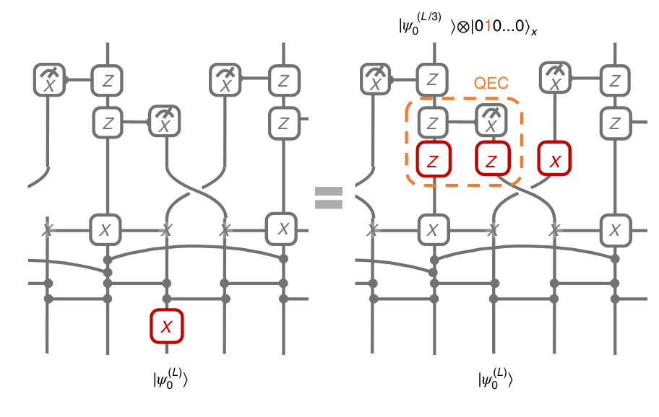
Quantum Error Correction (QEC)
Notes:
With such reversed MERA structure, the input data has to be error free which can be generated in the MERA, otherwise the QCNN cannot obtain a definitive solution. Thus, Quantum Error Correction (QEC) is applied, therefore this problem can be solved to give additional degrees of freedom. Briefly, within the pooling layers, instead of injecting new qubits in MERA, QCNN measures one of qubits and perform the rotation on the remaining ones depending on the measurement outcome.

Slide 15
QCNN Application
Notes:
The Architecture discussed above could be used to solve real quantum problems.

Slide 16
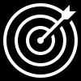
Quantum Phase Recognition
Condensed Matter Physics
Different quantum phase of matter
Solid, Liquid, Gas
Phase boundaries are complicated
Given a quantum many-body system in unknown state ρ, does it belong to a particular quantum phase P ?
Notes:
One very natural application of QCNNs is classifying complex quantum states.
In condensed matter physics, distinguishing different quantum phase of matter, such as solid, liquid and gas is a challenge. The difficulties lays on that the phase boundaries between them can be very complicated. However, the study shows that QCNN could efficiently solve this problem.
In detail, the goal is to identify whether a given quantum many-body system in unknown state ρ (rho) belongs to a particular quantum phase of matter P.

Slide 17
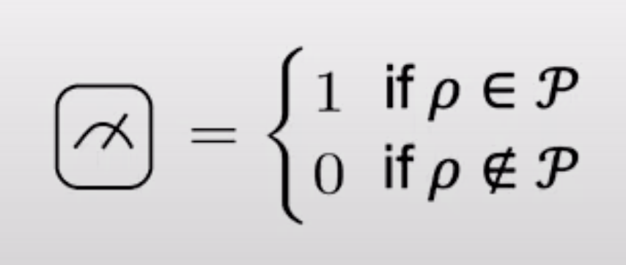
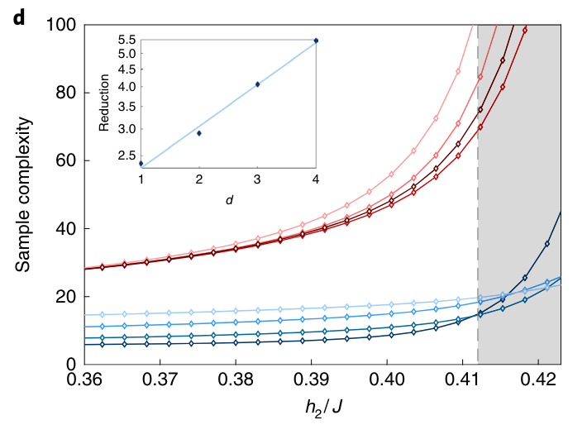
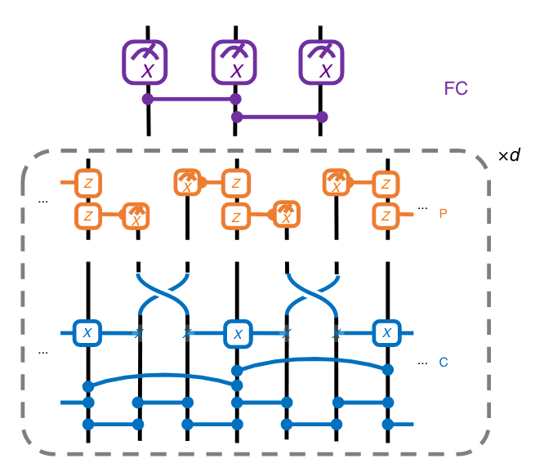
Quantum Phase Recognition
Notes:
The input of the model is a 1-dimension cluster state. Using the architecture we just mentioned, this problem could be solved by simply measuring the final state of QCNN. If its expectation value of final state is close to 1, we conclude that the input state belongs to the given phase, while if it’s close to 0, the input state is not in that phase.
The QCNN model outperform the traditional methods for this problem by using much fewer copies of input state and giving the results with same confidence.

Slide 18
Optimizing Quantum Error Correction
Qubit Error
Bit Flip Error (Poly X)
Phase Flip Error (Poly Z)
Classical Method
(e.g.) Repetition Code: 0 -> 000 1-> 111
Works well for single qubit error
Correlated Errors
Given an unknown error model, find the error correction code to protect against these errors
Notes:
Another application is the optimisation of quantum error correction.
Due to the unavoidable errors from qubit and gate, error correction algorithm is necessary for quantum computation.
The errors on a single qubit can be classified as bit flip error and phase flip error.
Classical error correction method, such as repetition code, works well for single qubit errors. But in real world there are correlated errors affect more than one qubit at once.
So the problem is given an unknown error model, how to efficiently find the error correction code to protect against these errors.

Slide 19
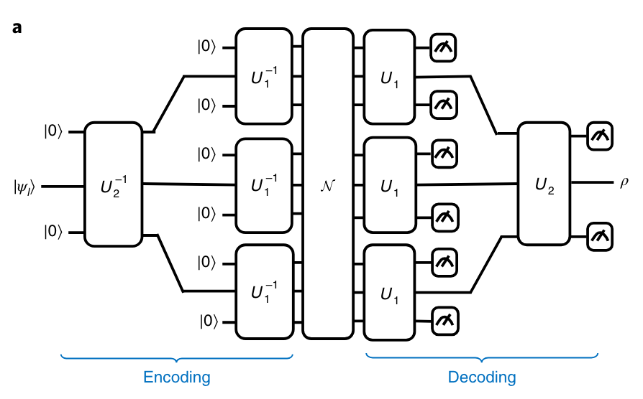
Optimizing Quantum Error Correction
Notes:
Inspired by similar structure of quantum error correction and QCNN, we build an encoder-decoder model to simulate the processes of converting single logical qubit to multiple physical qubit and converting physical qubit back to logical qubit.
Though the state after decoder may slightly differ from original code, by maximising the overlap states, the performance of QCNN model outperform other known code when there are correlated errors.

Slide 20
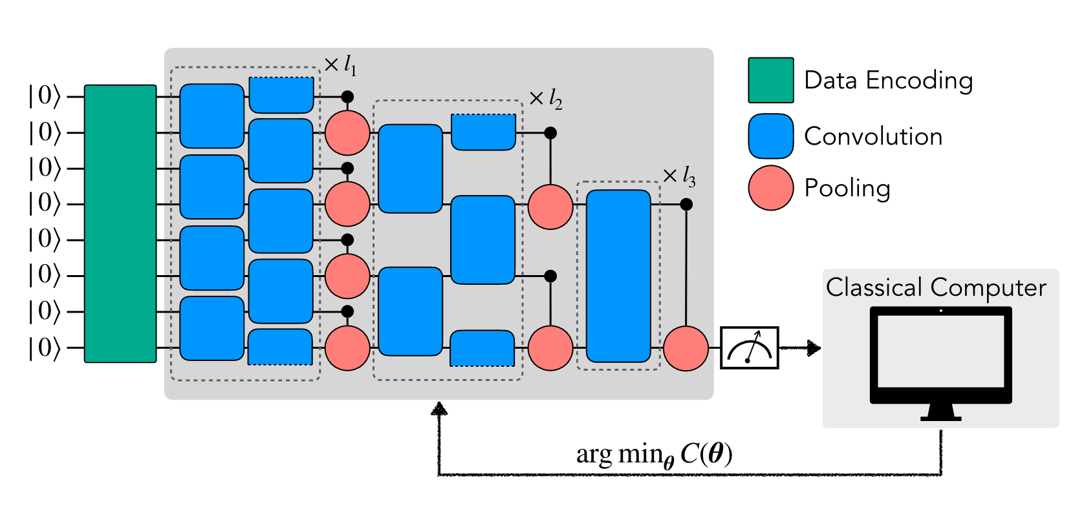
Classical Data Classification
Notes:
Finally, this structure can also be used to performing pattern recognition on classical data, such as image classification.
As the graph shows, this task involves the feature map from classical data to quantum state, the convolutional filters and pooling layer.

Slide 21
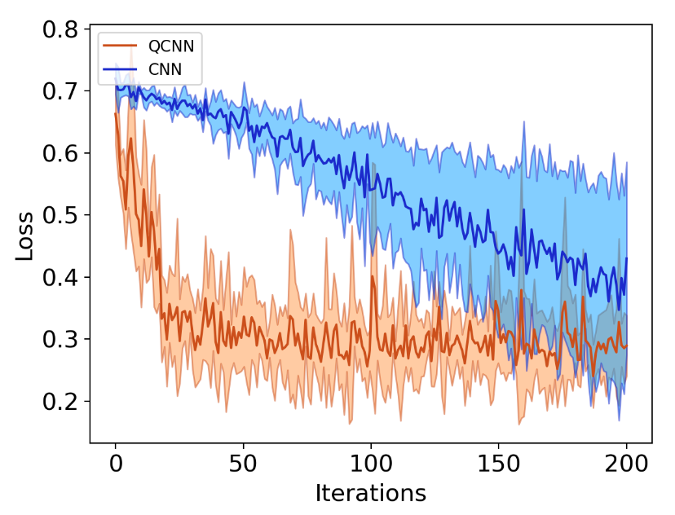
Classical Data Classification
Data Encoding
Amplitude Encoding
|φ(x_i)〉 = x_i |i〉
Qubit Encoding
|φ(x_i)〉 = cos( x_i/2 ) |0〉+ sin( x_i/2 ) |1〉
Dense Qubit Encoding
Hybrid
Notes:
There are several ways to encode classical data, including amplitude encoding, which encode the normalised input data with probability amplitudes of quantum state,
qubit encoding, which maps each input data between 0 and pi to a qubit. The data encoding is fixed in a given structure, while the convolutional filter and pooling use parameterised quantum gates.
And the classical computer is used to compute the new set of parameters.
The experiments shows that compared to pure CNN, QCNN achieves higher accuracy with smaller standard derivation and less iterations.

Slide 22

Conclusion
Advantage
Less parameters
Faster training
Error correction
Disadvantage
Hardware limitation
Our Research
Apply QCNN to small classical dataset
Encoding Methods
Quantum Circuits
Depth of Layer
Notes:
To conclude, qcnn can achieve good performance with less parameters, and faster training. The Error Correction included in the qcnn also gives better and more stable results compared to classical methods. However, due to the hardware limitation, qcnn is hard to applied to large input currently.
And in our research, we are planning to apply qcnn to small classical datasets, and try to implement it considering the choice of encoding method, design of quantum circuits and the number of layers, then compare its performance with a classical method.

Slide 23
Reference
[1] I. Cong, S. Choi, and M. D. Lukin. Quantum convolutional neural networks. Nature Physics, 15(12):1273–1278, aug 2019.
[2] G. Evenbly and G. Vidal. Tensor network states and geometry. Journal of Statistical Physics, 145(4):891–918, jun 2011.
[3] T. Hur, L. Kim, and D. K. Park. Quantum convolutional neural network for classical data classification. Quantum Machine Intelligence, 4(1), feb 2022.
[4] G. Vidal. Class of quantum many-body states that can be efficiently simulated. Phys. Rev. Lett., 101:110501, Sep 2008.
Notes:
Here are the references. Thank you for listening.

Slide 24
Thanks

